Slide 1
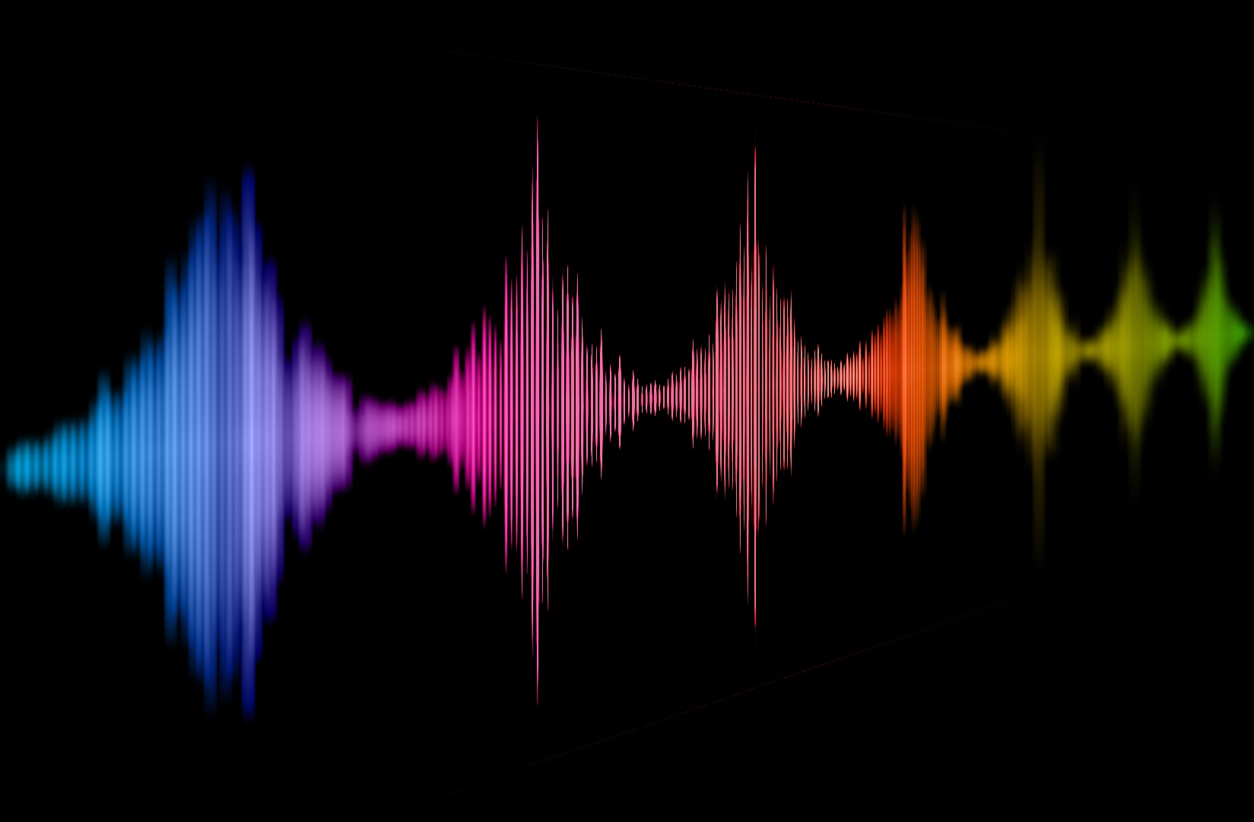
Naturalness of voices – from human to artificial agents
Christine Nussbaum, Sascha Frühholz, and Stefan R. Schweinberger
Voice ID 2024, Marburg, 29.08.2024
Naturalness of voices
Notes:
I´m obviously not Christine Nussbaum, and I am very sorry to say that Christine cannot give this talk today due to a health issue, so she asked me yesterday could I step in which I happily agreed – but please bear in mind that this talk is genuinely Tine´s and I hope you understand that I won´t be able to present it nearly as well as she would if she could.

Slide 2
Who of you…
…owns a smart home device with a voice assistant?
… almost lost their temper while trying to communicate with a synthetic voice assistent in a service hotline?
… suffered through a meeting/talk because the speaker had such a bad cold (or another type of voice condition) that it was almost painful to listen?
… played around with voice manipulation tools (like voice morphing or pitch transformation) and accidently ended up with some undesired artefacts in the vocal material?
-> Naturalness in voices
Notes:
Some warm-up questions.
…owns a smart home device with a voice assistant?
… almost lost their temper while trying to communicate with a synthetic voice assistent in a service hotline?
… suffered through a meeting/talk because the speaker had such a bad cold (or another type of voice condition) that it was almost painful to listen?
… played around with voice manipulation tools (like voice morphing or pitch transformation) and accidently ended up with some artefacts in the vocal material?
And as an add-on to the last one: who used some of these stimuli for their study nevertheless? ;) Ok hesitation but Tine told me she would raise her herself and on reflection I should do this to – and all this brings us to the issue of

Slide 3
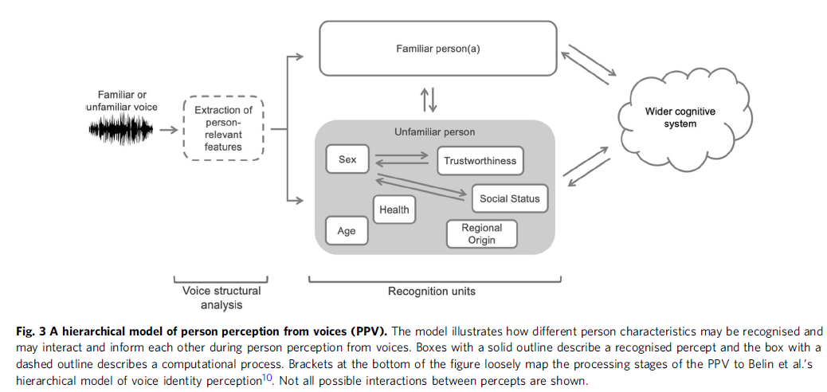
Person Perception from Voices (PPV)
Naturalness
[Lavan & McGettigan 2023, Communications Psychology]
Notes:
This is from Nadin Lavan´s and Carolyn McGettigan´s recent model of person perception from voices, and what you can see is that
whenever we hear a voice we form multiple impression immediately
Many of them are well studied, like age gender, personality impressions or regional origin, but
Ss we would like to argue that Ss naturalness refers to one of these impressions
It´s perhaps equally important, but it also is completely understudied
Next 15 minutes is an advertisement talk, why I think we should study naturalness
So this talk is also about the meta-perspective – and we reflect on how current research on voice naturalness is conducted

Slide 4
Our Motivation
“Impairments in speech naturalness can lead to communication partners perceiving the affected individuals as unhappy, cold, withdrawn, introverted, or bored. These false perceptions can interrupt participation in regular life roles, leading to loss of employment and independence. Thus, impaired speech naturalness can result in social isolation, reduced quality of life, and depression.” (Stepp & Voijtech, 2019)
Our Mission:
A systematic understanding of vocal naturalness
“The growing popularity of speech interfaces goes hand in hand with the creation of synthetic voices that sound ever more human. Previous research has been inconclusive about whether anthropomorphic design features of machines are more likely to be associated with positive user responses or, conversely, with uncanny experiences. To avoid detrimental effects of synthetic voice design, it is therefore crucial to explore what level of human realism human interactors prefer and whether their evaluations may vary across different domains of application.” (Schreibelmayer & Mara, 2022)
“It is like my toaster is speaking to me.” (Kühne et al. 2020)
Notes:
And our base motivation to study naturalness is because it simply affects how we interact with the voice (or the source of that voice)
Let us give you some prominent quotations to back this..
One is about pathological voices (read)
Impairments in speech naturalness can lead to communication partners perceiving the affected individuals as unhappy, cold, withdrawn, introverted, or bored. These false perceptions can interrupt participation in regular life roles, leading to loss of employment and independence. Thus, impaired speech naturalness can result in social isolation, reduced quality of life, and depression.” (Stepp & Voijtech, 2019)
One about voice synthesis
The growing popularity of speech interfaces goes hand in hand with the creation of synthetic voices that sound ever more human. Previous research has been inconclusive about whether anthropomorphic design features of machines are more likely to be associated with positive user responses or, conversely, with uncanny experiences. To avoid detrimental effects of synthetic voice design, it is therefore crucial to explore what level of human realism human interactors prefer and whether their evaluations may vary across different domains of application.” (Schreibelmayer & Mara, 2022)
The last comes from a qualitative analysis where people were asked why they judged a voice as unnatural – and I think it is Tine´s personal favourite: It is like my toaster is speaking to me

Slide 5
Research on naturalness – a systematic literature search
Web of Science search on 26 April 2023 and 28 May 2024
“naturalness AND voice” and “human-likeness AND voice”
Inclusion critaria:
Published in English
Peer-reviewed journal or conference contribution
Voice naturalness/human-likeness was either measured or manipulated
Quantitative empirical data or integration of these
Spoken utterances only (no singing voices or nonverbal vocalizations)
72 publications
[Nussbaum, Frühholz & Schweinberger (2024), under review in Trends in Cognitive Sciences]
Voice Naturalness
Notes:
- To ground our claims a little bit on data, we conducted a little mini-review to get a representative overview of the research on naturalness that already exists
This is the „data basis“ of the talk
Web of Science search on 26 April 2023 and 28 May 2024
“naturalness AND voice” and “human-likeness AND voice”
Inclusion critaria:
Published in English
Peer-reviewed journal or conference contribution
Voice naturalness/human-likeness was either measured or manipulated
Contained Quantitative empirical data or integration of these
We focussed on Spoken utterances only (no singing voices or nonverbal vocalizations – only three studies)
Overall this resulted in 72 publications

Slide 6
Research on naturalness – overview
year range: 1984 – 2024 (53% published in the last 5 years)
67 report empirical data (of these 48 rating data)
2 literature reviews
3 using neurophysiological measures (EEG, fNIRS)
Voice categories:
33 synthetic
18 human-pathological
6 human-manipulated
5 healthy human voices
10 used more than one of these voice categories
[Nussbaum et al., under review, TiCS]
Notes:
Just overview over basic numbers
year range coveredt the past 40 years but more than half of the papers were published in the last 5 years - seems a hot topic
There are 3 main domains here Ss:
pathological human voices
manipulated human voices
Biggest single group were studies on synthesized/artificial voices (and some studies could be classified into more than one category)

Slide 7
Current problems in voice naturalness research
Conceptual underspecification
Inconsistent operationalization
Lack of exchange between different research domains
Insufficient anchoring in voice perception theory
Precluded a systematic understanding of vocal naturalness
Impeded the visibility of this research to a wider readership
Has kept us from asking some crucial research questions
Has led to a divergence between theory and practice
[Nussbaum et al., under review, TiCS]
Notes:
Before I continue with problems of this research, we wish to make really clear: this is all valuable research (our claim certainly is not that everything done until this point is bad work)
BUT If you want to see the „bigger picture“, if you want to understand voice naturalness, this is close to impossible due to the way this research has been conducted and conceptualized.
We identified 4 main problems
Conceptual underspecification
Inconsistent operationalization
Lack of exchange between different research domains
Insufficient anchoring in voice perception theory
In detail later we adress 1, 3 and 4, but each of these has
Precluded a systematic understanding of vocal naturalness
Impeded the visibility of this research to a wider readership
Has kept us from asking some crucial research questions
Has led to a divergence between theory and practice

Slide 8
Towards a concise framework for voice naturalness
Notes:
- So trying to define voice naturalness is already a tough challenge

Slide 9
Defining voice naturalness – quite a challenge
“Naturalness was defined as conforming to the listener’s standards of rate, rhythm, intonation, and stress patterning […] ” [e.g. Yorkston et al. 1990]
“Natural speech is the speech most closely perceived as a human voice“ [e.g. Mawalim et al. 2022]
"By naturalness, we understand the voice stimulus to be perceived as a plausible outcome of the human speech production system.“ [Nussbaum et al. 2023]
only 32 out of 72 publications provide an explicit definition
[Nussbaum et al., under review, TiCS]
Notes:
Here are some examples of definitions from the paper corpus Ss
read out Ss our own
In essence, we found that where there are definitions, they tend to be tailored to the research focus of the individual study (pathological vs synthetic)
We also found that only 32/72 papers actually provide an explicit definition

Slide 10
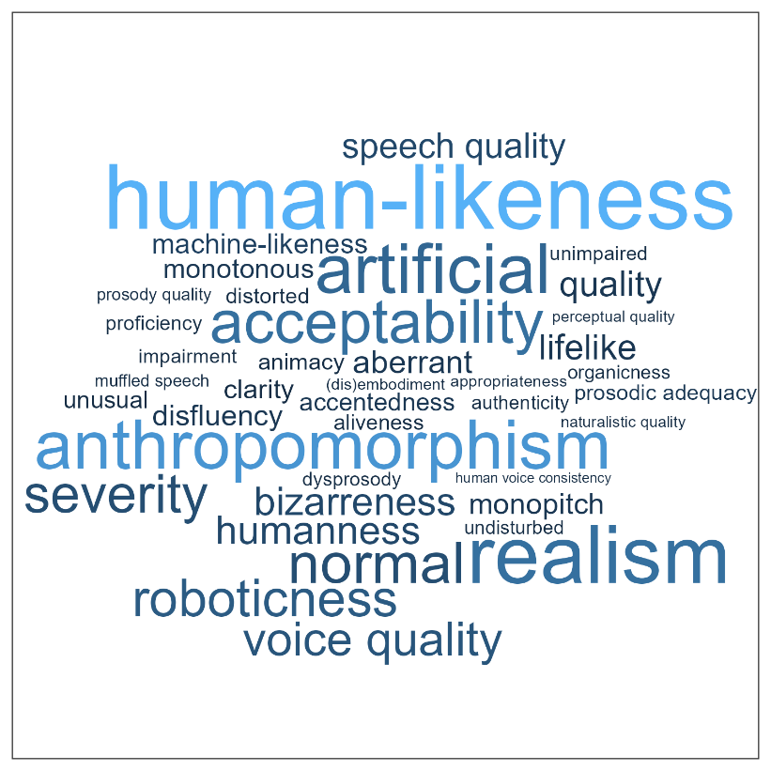
Inconsistent terminology
58 papers provided keywords
32 had keywords related to naturalness or any of its synonyms
[Nussbaum et al., under review, TiCS]
Notes:
- We can try to get a grasp of the verbal space we are dealing with
- so this word cloud is extracted from the paper database and shows synonyms or concepts related to naturalness (based on an analysis of the entire text)
- but the fact that only under half of these papers actually had keywords that were related to naturalness or any of its synonyms obviously raises questions like how many papers we may NOT have found because they use different wording

Slide 11
Proposing a taxonomy for the definition voice naturalness
(1) Deviation-based naturalness
(2) Human-likeness-based naturalness
Deviation from a reference that represents maximum naturalness
Human-likeness i.e. resemblance to human voice
27 employed a deviation-based conceptualization, 35 used human-likeness, and 10 used a combination of both
[Nussbaum et al., under review, TiCS]
Notes:
To address all this, we propose a taxonomy with two different main variants of voice naturalness. The first is deviation-based naturalness. In Ss deviation-based naturalness, naturalness is defined as the deviation from a reference that represents maximum naturalness. This conceptualization needs two important specifications: the reference representing maximum naturalness, and the type of deviation. In some cases, the reference is explicitly provided e.g. through a comparison or baseline stimulus. However, in many studies, raters are instructed to use an inner implicit reference which is based on their experience and expectations.
((The type of deviation is specified through the vocal material. It can virtually cover all acoustic features, ranging from specific manipulations (e.g., spectral features or speech rate [10,63,64]) to complex multivariate vocal patterns (e.g., in distorted or pathological voices [65])).
The second variant, Human-likeness-based naturalness defines naturalness via its resemblance to a real human voice. Compared to the deviation-based definition, it comes with an important additional assumption: the existence of a non-human voice category, and hence a categorical boundary to human voices (although the transition between categories can be gradual). In other words, a definition of human-likeness is only meaningful if we assume that voices can be non-human in principle. Apart from this important distinction, human-likeness-based naturalness may be seen as a special case of deviation-based naturalness: the reference is a human voice (or listeners´ representation of a plausible range of human voices), and the deviation is on the human/non-human spectrum.
Ss And you can see that the vast majority of papers we screened actually use one of those two definitions, and some used a combination.

Slide 12
Lack of exchange between different research domains
Notes:
Problem 3 we identified was lack of exchange between different research domains

Slide 13
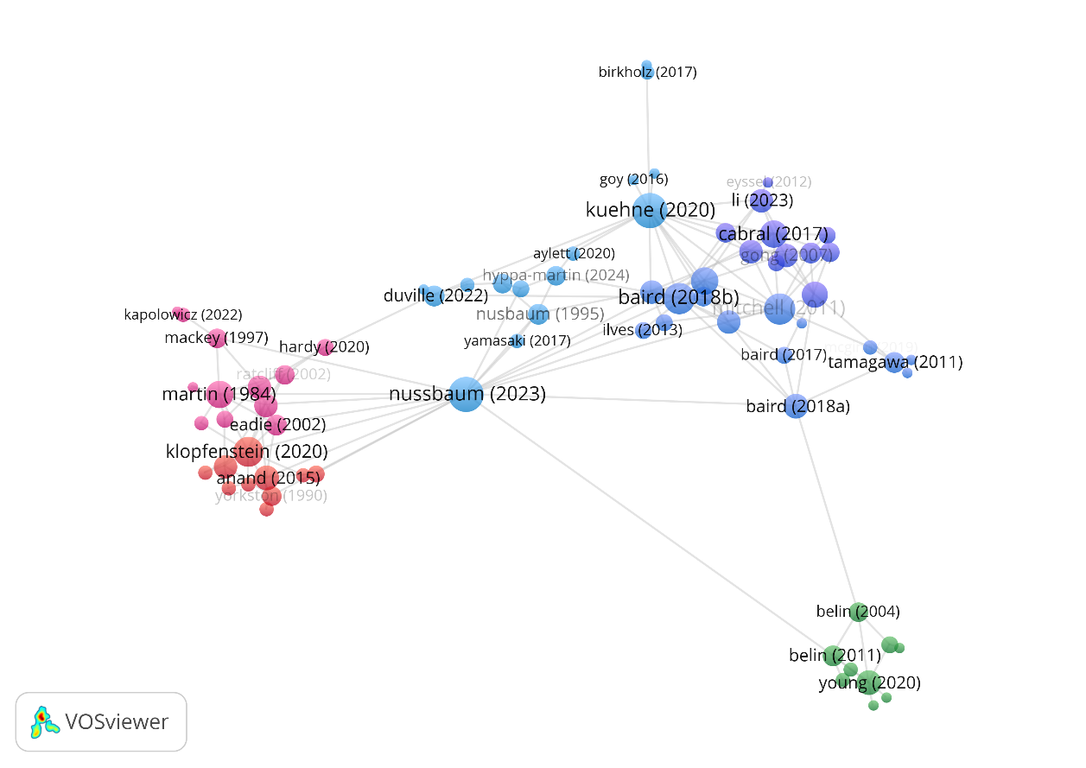
(Lacking) interconnectivity of voice naturalness research
[Nussbaum et al., under review, TiCS]
Notes:
Here´s the data – This figure actually illustrates the lack of interconnectivity between different research domains. The red and blue dots represent the 72 paper in the database, with red colours reflecting papers on voice pathology, and blue reflecting papers primarily on synthetic voices
(By the way, green reflects 10 influential voice theory papers - we come to that later)
But up here, The important point is that within each domain these papers show many mutual citations, but they are almost not referring to each other across domains. Each line represents a cross-citation between two specific papers.
So these are almost like echo chambers within science – naturalness research in voice synthesis doesn´t refer to naturalness research in voice pathology and vice versa.

Slide 14
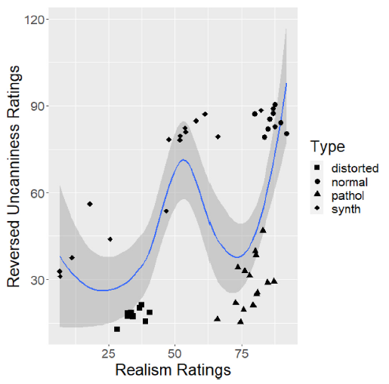
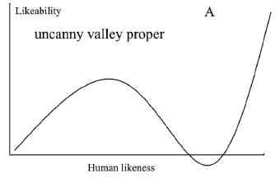
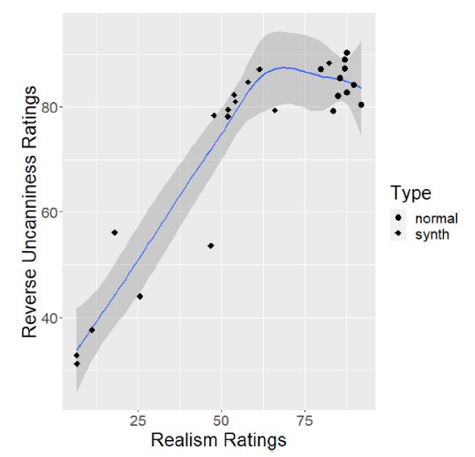
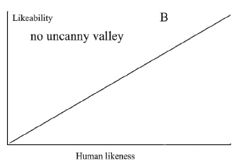
Pooling evidence from all possible research angles
[Diel & Lewis (2024), Computers in Human Behavior]
Notes:
- You could say what´s the problem if fields are not really connected?
- They have very diferent persepctives and aims - so why bother bringing them together?
But WE ARGUE that for a complete picture, for progress in understanding of voice naturalness, we need to pool evidence from all possible angles and fields.
Here is one current example to illustrate that
This paper just came out 2 months ago, and asks whether there is an uncanny valley for human voices. In fact, it´s the only one of a small number that looked at this phenomenon for different voice categories including pathologigal, synthesized, manipulated and healthy human voice. What´s the UV? Ss Essentially, with greater human likeness social stimuli are also rated more likable, but the uncanny valley reflects a dip in likeability just in the eerie region where a stimuus is perceived as almost but not quite human. Ss In fact, this study (and several other studies) did not find evidence for an UV in the case of synthetic voices, but when you integrate across all categories Ss, then Diel and Lewis argue that they clearly find an UV effect - although you can see that this effect is clearly driven by the pathological voices.

Slide 15
Insufficient anchoring in voice perception theory
Notes:
Last issue: Insufficient anchoring in voice theory

Slide 16
(Lacking) interconnectivity of voice naturalness research
[Nussbaum et al., under review, TiCS]
Notes:
Remember the green guys here reflect influential voice theory papers, so
Coming back to this pattern, another point we noted is that there is almost a complete lack of linkage of these papers (with very few notable exceptions) to voice perception theory – these papers simply make no reference to theory and this is what we mean here
Not rooted in voice perception theory (only 10 papers, but the picture remains the same if all approx 200 papers that were cited by Belin 2011 are included. all Metadata are from WoS)

Slide 17
Rooting voice naturalness in voice processing theory
[Nussbaum et al., under review, TiCS]
Notes:
Take description from paper
Theories of voice perception propose a multi-level processing of voice samples (left) and analyzing these samples according to their feature and auditory object patterns (mid panel), followed by the analysis of social information carried by the voice signals (right). We propose that assessing the naturalness of voices appears at the levels of voice features in low-level auditory analysis and voice structural analysis, and it includes the assessment of acoustic deviations and acoustic likeness, as well as the assessment of pattern deviations and pattern likeness to reference voice samples. Unlike naturalness assessments, authenticity judgments mainly concern the assessment of communicative and social content. Such voice content can be expressed either spontaneously (authentic) or can be enacted (non-authentic), or it could be of a real or fake nature when it specifically concerns person-related identity information. So in a way our taxonomy also provides a conceptual framework to distinguish voice naturalness from voice authenticity (in the sense of is this an authentic emotion? Or is this an authentic identity) – and we hope that people find this framework useful as a working model.

Slide 18
Practical recommendations for voice naturalness research(ers), regarding
Conceptual underspecification
Inconsistent operationalization
Lack of exchange between different research domains
Insufficient anchoring in voice perception theory
Offer a concise definition of voice naturalness (to both participants and readers).
Use consistent keywords to make research findable
Fully report methodological details, ideally with stimulus examples
Communicate findings inclusively enough for diverse readerships
Link research to current insights in voice perception theory and a broader multimodal context
Quantify naturalness, whenever it could have important implications for ecological validity of the stimulus material, even when naturalness is not the primary focus of the study.
Notes:
Offer a concise definition of voice naturalness to both participants and readers. With the taxonomy of naturalness in Section 3, we offer a conceptual framework that can be tailored to any empirical design, e.g. by specifying the reference and the type of deviation under study. If used consistently, this taxonomy offers quick orientation for readers and fosters comparability across findings.
Use consistent keywords to make relevant research findable across disciplines. We recommend “naturalness”, “human-likeness” or, in cases discussed in Section 3.2, “authenticity”.
Include full reports on methodological details, including acoustic manipulations, measurements, instructions to raters, and reports on reliability.
Wherever possible, provide stimulus examples. Often, direct auditory impression can be complementary to, and more insightful than a list of acoustic measures and descriptions. In some cases, differences in audio material may offer a straightforward explanation for different empirical outcomes.
Communicate findings inclusively enough for readerships from diverse backgrounds. Provide explicit definitions, avoid technical jargon, adopt scientific standards from other fields where appropriate, and discuss findings against the wider interdisciplinary literature.
Quantify naturalness, whenever it could have important implications for ecological validity of the stimulus material, even when naturalness is not the primary focus of the study. This is especially important when using acoustic manipulations which could have unintended side effects on perceived naturalness
Provide explicit definitions, avoid technical jargon, adopt scientific standards from other fields where
appropriate, and discuss findings against the wider interdisciplinary literature.

Slide 19
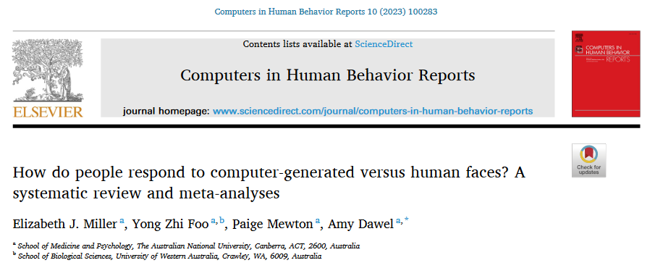
Including the multimodal perspective
2023
Notes:
Last not least: I don´t have time to talk about the multimodal perspective, but it seems clear that voice naturalness research should be interconnected with research on naturalness in other modalities, and so this is also a domain for which voice research can benefit from considering results from other domains. This paper is a really good example because it is recent meta-analysis on natural vs. synthesized faces. But ultimately, we will have to use multimodal and dynamic stimuli to approach an ecologically valid understanding of human naturalness.

Slide 20
Take home messages
Perceived naturalness is a voice feature we should study systematically.
We propose a conceptual framework:
Deviation-based naturalness
Human-likeness-based naturalness
For a more complete understanding of voice naturalness, we need to pool evidence from all the interdisciplinary literature.
Research efforts on voice naturalness should be rooted in voice perception theory.
Notes:
Durchklicken und vorlesen
Perceived naturalness is a voice feature we should study systematically.
We propose a conceptual framework:
Deviation-based naturalness
Human-likeness-based naturalness
For the complete picture, we need to pool evidence from the entire interdisciplinary literature.
Research efforts on voice naturalness should be rooted in voice perception theory.

Slide 21
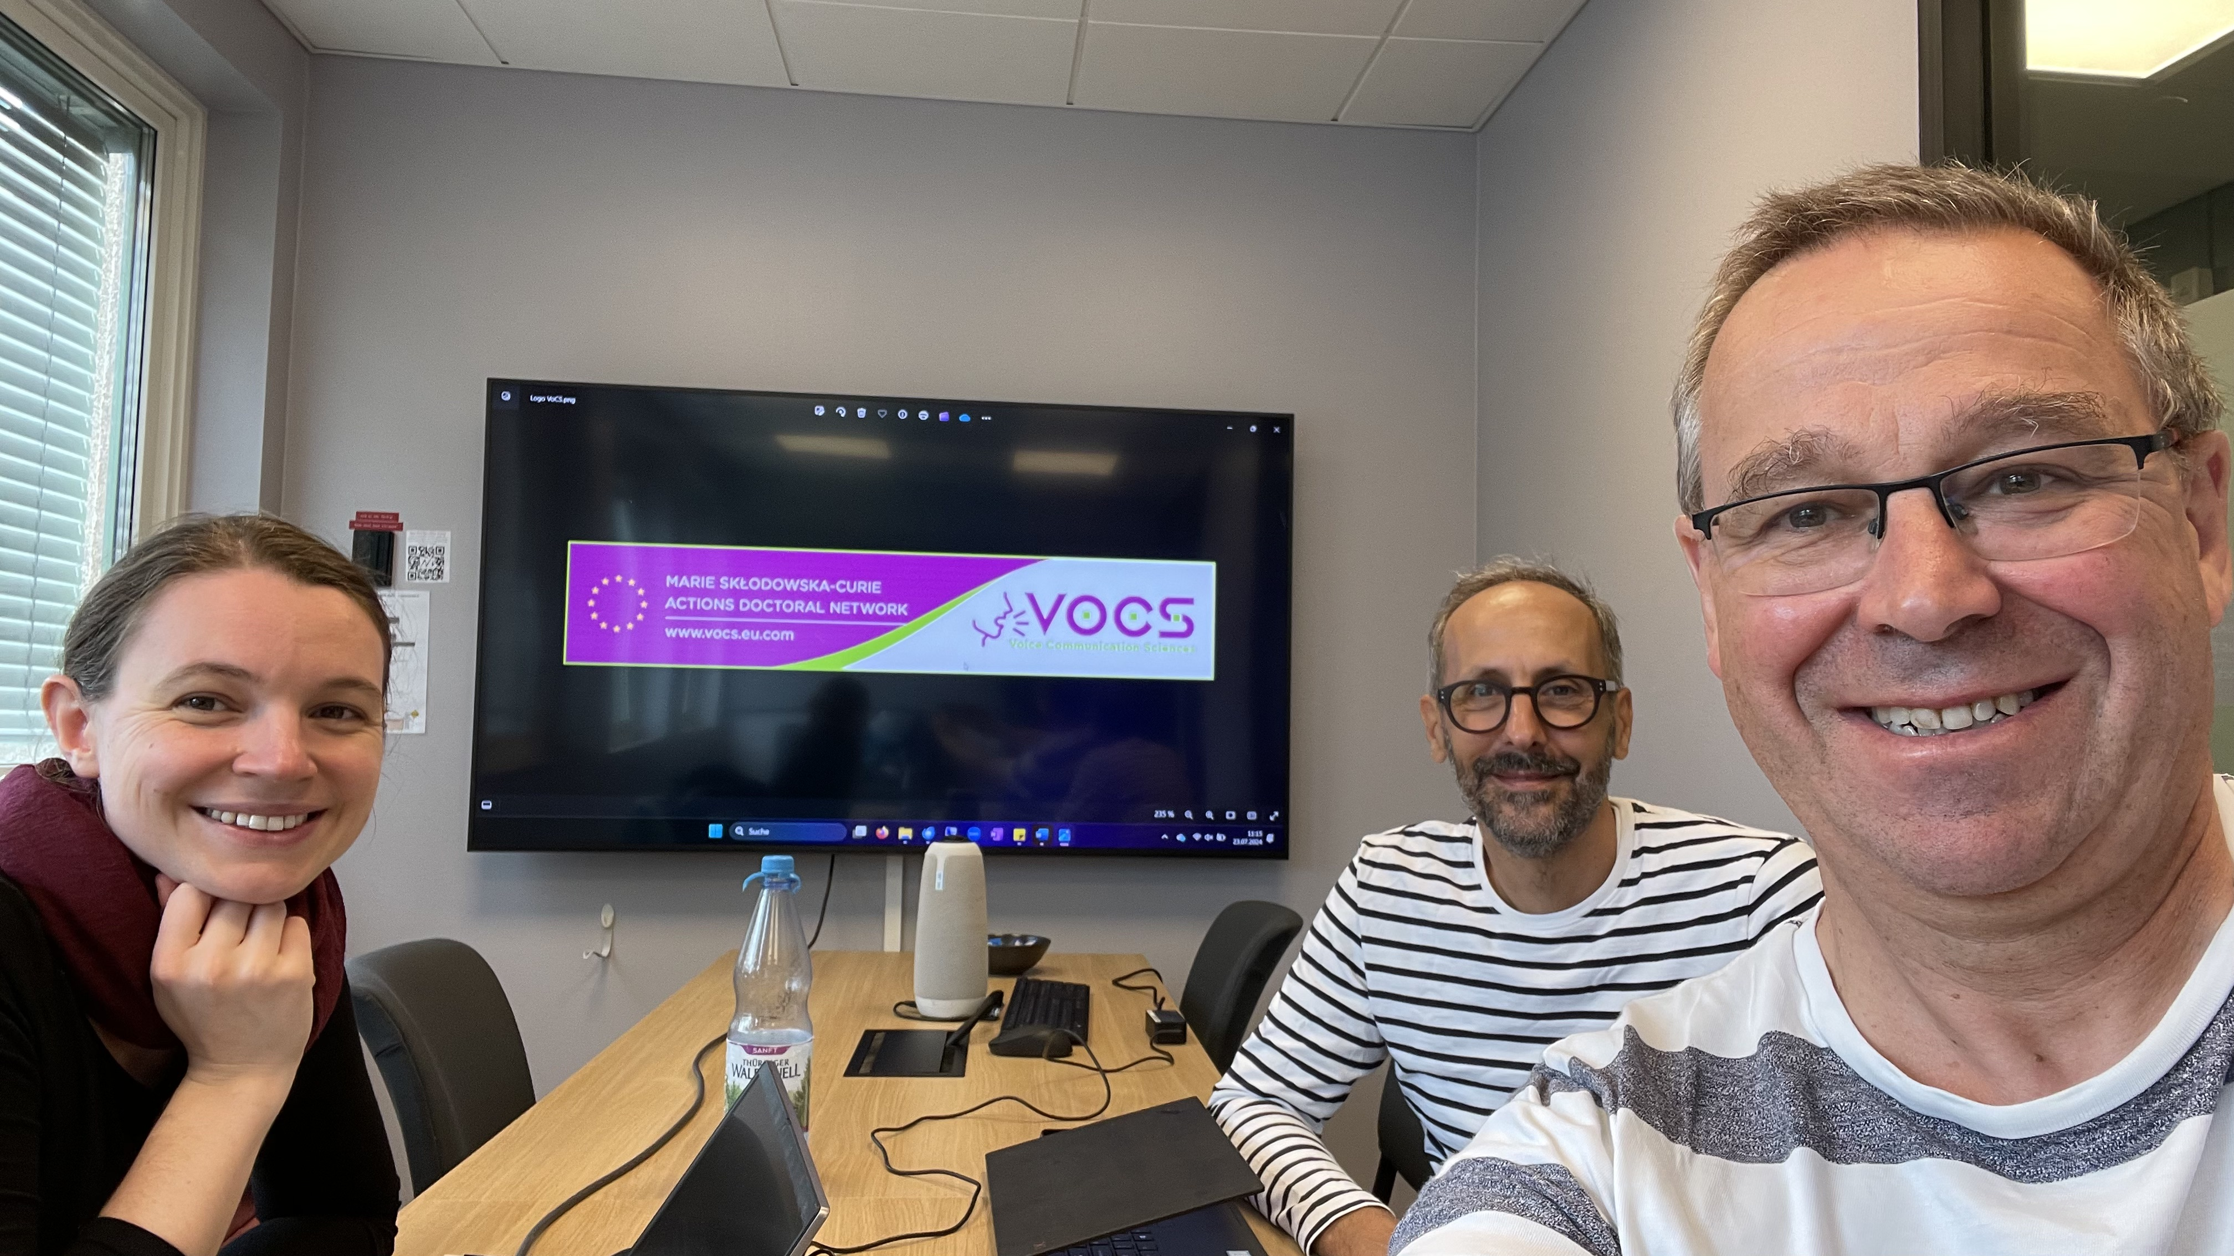
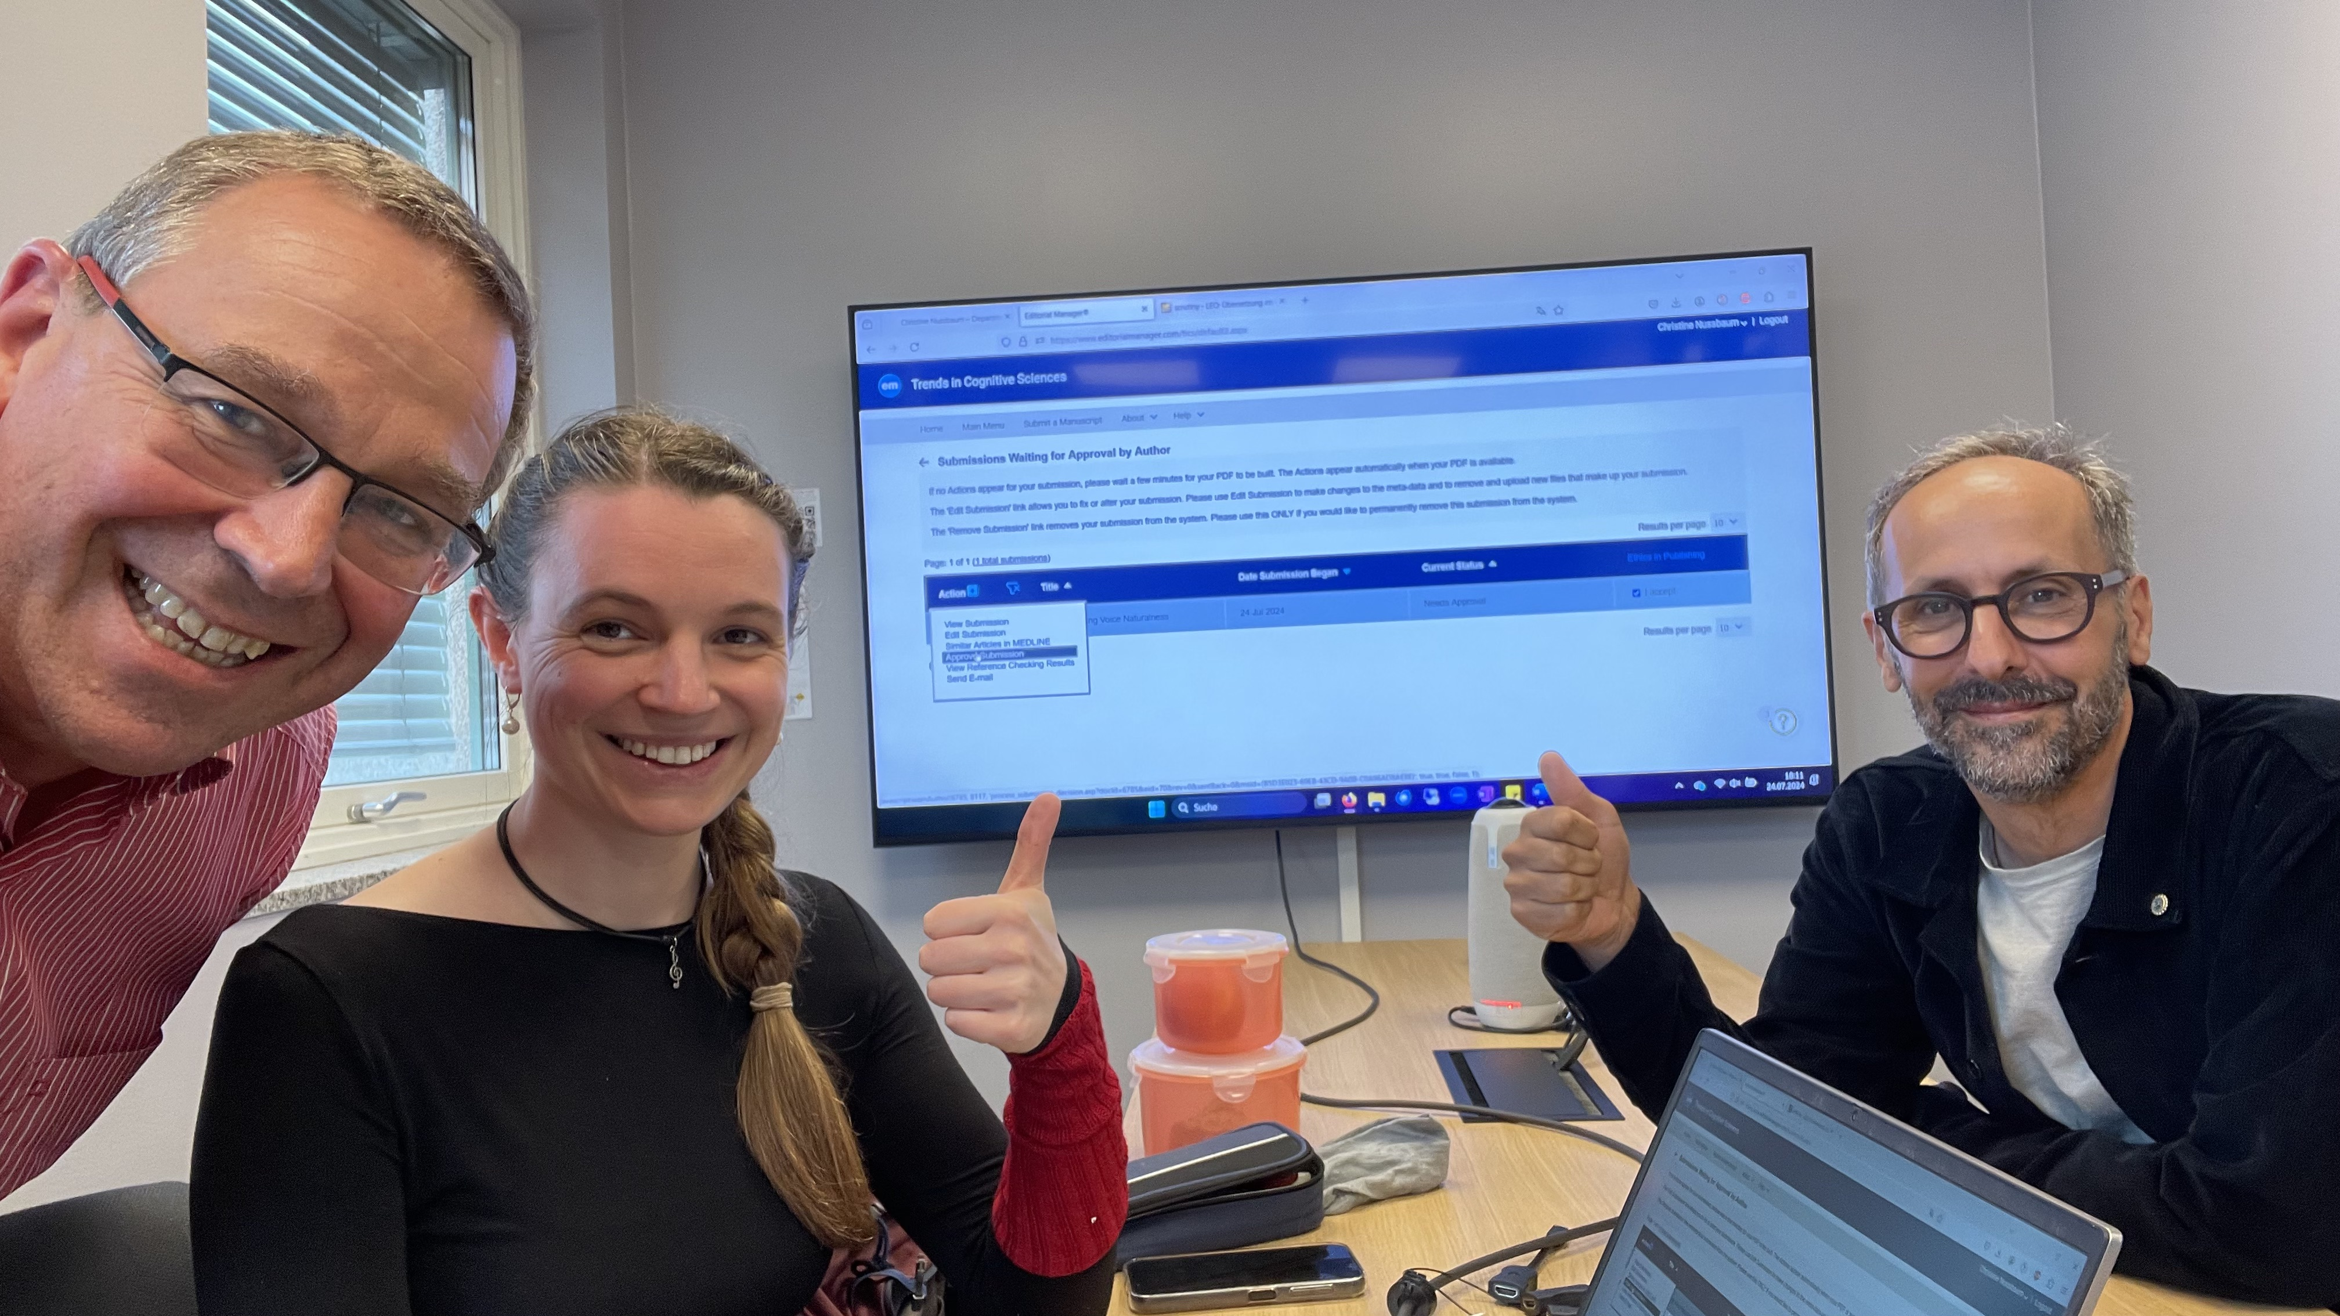
Thank you for your attention ☺
Notes:
This last slide is the only one to which I made a surprise change to Tine´s slides, because Ss I smuggled in two fotos from Oslo from last month. The first comes with greetings from Tine and Sascha Frühholz who we visited and who regretfully can´t be at this VoiceID, plus the logo of VOCS which is an EU-wide project for which we owe big thanks to Pascal and Thierry for coordinating this (Pascal will tell you all about it this afternoon). The second shows, a few days later, Tine in the center and our team at the very second when Tine pressed the submit button for the paper that Tine´s talk was about. All the good aspects of this talk are genuinely hers, and please blame all the things that remained unconvincing on me.
Ss Thank you very much for your attention!

